Slide 1


Unit 3
Data collection in health facilities
Notes:
Welcome to Unit 3 of Module 6.

Slide 2
By the end of this unit, you will be able to:
identify the procedures to be followed by the data collection team before arrival at facilities, on arrival at facilities, and on arrival at the service site
Notes:
By the end of this unit, you will be able to identify the procedures to be followed by the data collection team before arrival at facilities, on arrival at facilities, and on arrival at the service site.

Slide 3


Before arrival at facility
Notify
the facility in-charge ahead of time
Arrive early
easier to get cooperation at the beginning of the day
Be prepared
have all the necessary tools and supplies
The team should be very familiar with the questionnaire and tools before starting data collection.
Notes:
Before arrival at the facility, the team leader should notify the facility in-charge well in advance of the time that the data collection team will arrive at the facility. ​
It is important to arrive early at the health facility. This is because it is easier to get cooperation and support at the beginning of the day, before staff get too busy. ​​
The team should be well prepared for the visit and have all the necessary tools and supplies.
They should also be very familiar with the questionnaire and tools before starting data collection.

Slide 4

Before arrival at facility
Plan for lunch at the facility
no time to leave the facility
respondents may only be available during lunchtimes
facility may have limited lunch choices available
bring snacks and water
Notes:
The team should plan for lunch at the facility. ​
​They may not have time to leave the facility and some respondents may only be available during lunchtimes. ​
​Furthermore, the facility may have limited choices available for lunch. ​
​Therefore, it is a good idea to bring snacks and water. ​
​In places where it gets hot and energy may dwindle – a snack can make all the difference!

Slide 5
On arrival at facility
Locate and verify the survey facility
if the team cannot locate a facility, contact the area supervisor for advice
if a facility on the list has closed, a replacement facility will be assigned to the team
The team should not visit and survey any facility that is not included on the team’s list.
Notes:
When the data collection team is nearby the facility, they must locate and verify the survey facility.
If, after contacting local authorities, the team cannot locate a facility on their list, or are not sure if the facility that they have found is the one identified on the list, the team leader should contact the area supervisor for advice.​
​
If a facility included in the list has closed, the area supervisor should be informed, and a replacement facility will be assigned to the team.​
​
The team should not visit and survey any facility that is not included on the team’s list, unless specifically approved in advance by the area supervisor and survey manager.​

Slide 6



On arrival at facility
Validate the cover page of the questionnaire
Team leader checks that the identifying information in questionnaire Section 1 is complete
If there are any errors, the team leader informs the area supervisor at the end of the day
Notes:
The first step on arrival at the facility is to validate the cover page of the questionnaire.
Before starting data collection, the team leader should check that the identifying information in questionnaire Section 1 (that is pre-filled in CSPro) is complete and correct.
If there are any errors, the team leader should inform the area supervisor at the end of the day.

Slide 7

On arrival at facility
Take geographic coordinates
Geographic coordinates are collected through GPS
GPS coordinates use a space-based satellite system
Used to locate the geographic position of the facility
Notes:
Upon arrival at the facility and after validating the cover page, the data collection team takes the geographic coordinates of the facility as indicated in the questionnaire. ​
​The geographic coordinates are collected through GPS, which stands for global positioning system​.​
The GPS coordinates, which use a space-based satellite system, are used to precisely locate the geographic position of the facility.

Slide 8
On arrival at facility
Meet with the facility in-charge
reassure facility staff that individual respondents will not be identified
The team leader should:
introduce the team
respond to any questions and concerns
give the facility in-charge the letter of introduction
request consent to conduct the survey
explain the purpose, activities and estimated duration of the visit
ask the facility in-charge to sign the Informed Consent form
Notes:
The next step is to meet with the person in charge of the facility (sometimes called the “facility in-charge”). This first contact at the facility should be made by the team leader. ​
​
The team leader should:​
​
introduce the team;​
give the facility in-charge the letter of introduction provided by the ministry of health;​
explain the purpose of the visit, the activities that are part of the survey, and the estimated duration of the visit;​
reassure facility staff that individual respondents will not be identified;​
respond to any questions and concerns from the facility in-charge or other facility staff;​
request consent to conduct the survey; and​
ask the facility in-charge to sign the Informed Consent form provided by the ministry of health.​
​

Slide 9

On arrival at facility
Meet with the facility in-charge
Identify any services where staff need to be interviewed at specific times, for example:
services only offered at certain times
services where staff may leave early
services that may close early or during lunch
Notes:
After consent to conduct the survey has been obtained, the team discusses with the in-charge some important practical aspects of the visit.
​It is important to identify immediately any services where staff need to be interviewed at specific times, for example:​
​
services that are only offered at certain times; ​
services where staff may leave early; or​
services that may close early or during lunch.

Slide 10


On arrival at facility
Surgical, emergency, delivery, newborn care units
Laboratory and pharmacy services
easiest to organize
commonly close for lunch/
at specific times
lower risk of staff not present
request schedules to ensure staff are available
Notes:
The surgical, emergency, delivery and newborn care units are generally the easiest sections to organize, as there is a lower risk of staff not being present.
Laboratory and pharmacy services commonly close for lunch or at a specific time of the day, so it is important to request their schedules to ensure staff are available for data collection.

Slide 11
On arrival at facility
Identify facility staff to interview
Key informants
The team leader should ask the facility in-charge to:
managers, finance and health information system staff for availability and management sections
identify key informants
nurses in-charge and service providers for outpatient services
assign someone to take team members to the data collection sites / introduce them to staff at the sites
staff in charge of support services (e.g. laboratory, X-ray, pharmacy)
Notes:
Before data collection can start, the team needs to identify facility staff to interview.​
​For key informants, the following staff may be considered:​
managers, finance and health information system staff for the availability and management sections;
nurses in-charge and service providers for outpatient services;
staff in charge of support services such as laboratory, X-ray and pharmacy.​
The team leader should ask the facility in-charge to identify key informants, and to assign someone to take team members to the data collection sites and introduce them to the staff at the sites.
​

Slide 12


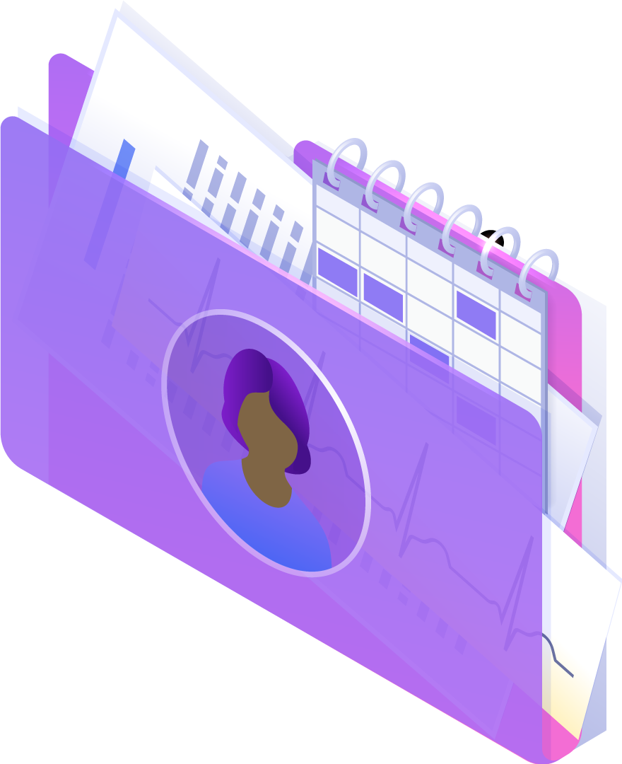

On arrival at service site
service providers are busy
patient rights need to be protected
The respondent’s time is required, so data collectors may need to compromise to find a suitable time for the interview.
Notes:
On arrival at the service site, it is important for data collectors to remember that:​
​service providers are busy; and​
patient rights need to be protected (for example the right to privacy and to receive services in a timely manner).​
The respondent’s time is required, however, so data collectors may need to compromise and negotiate to find a suitable time to conduct the interview. This can be facilitated by developing a good rapport with the respondent.​

Slide 13

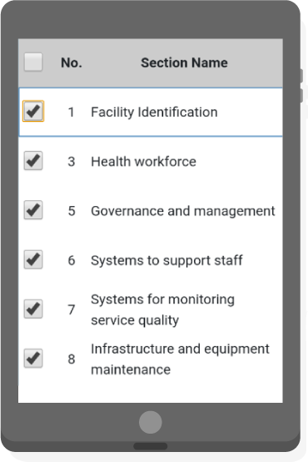
On arrival at service site
To achieve this, data collectors should:
be familiar with questionnaire sections and different respondents needed
be flexible with the order of data collection
It is important to minimize non-productive time by being organized.
contact the team leader if problems arise
Notes:
It is important to minimize non-productive time by being organized. To achieve this, data collectors should:
be familiar with the questionnaire sections and the different respondents that need to be interviewed;
be flexible with the order of data collection, depending on respondent availability; and
contact the team leader if problems arise.

Slide 14



On arrival at service site
request access and cooperation
explain information needed
reassure respondent about information needed
Notes:
After the person assigned by the facility in-charge has introduced the data collector to staff at the service sites, data collectors should: ​
request access to the site and the cooperation of the staff;
briefly explain the information that is needed and advise the respondent how much time will be needed to conduct the survey in the site; and
reassure the respondent, making sure they understand that the information will not be used in any way that will harm them, and that it is collected to inform planning and improve services.

Slide 15
On arrival at service site
When speaking to the respondent:
speak clearly and loud enough to be heard
if uncertain of response, check if a more appropriate respondent can be identified
read each question aloud exactly as it is written
avoid giving their own opinions on service conditions or patient care
listen carefully and without judgment
avoid promises for actions or changes
accurately record responses
thank the respondent
probe for additional information when necessary
verify there are no missing responses
Notes:
When speaking to the respondent, the data collector should:
speak clearly and loudly enough to be heard;
read each question aloud, exactly as it is written in the questionnaire;
listen carefully and without judgment to the responses;
accurately record the responses on the tablet;
probe for additional information when necessary, but avoid “leading” the respondent to an answer; and
remember that this survey collects facts and not opinions. If the data collector is uncertain of a response, they should check if a more appropriate respondent can be identified;
The data collector should also:
avoid giving their own opinions on service conditions or patient care;
avoid promises for actions or changes; and finally
thank the respondent and verify that there are no missing responses.

Slide 16
You have now completed Unit 3.
Now try the practice exercise and the end of module quiz.
Notes:
You have now completed Unit 3.
Now try the practice exercise and the end of module quiz.

